Slide 1
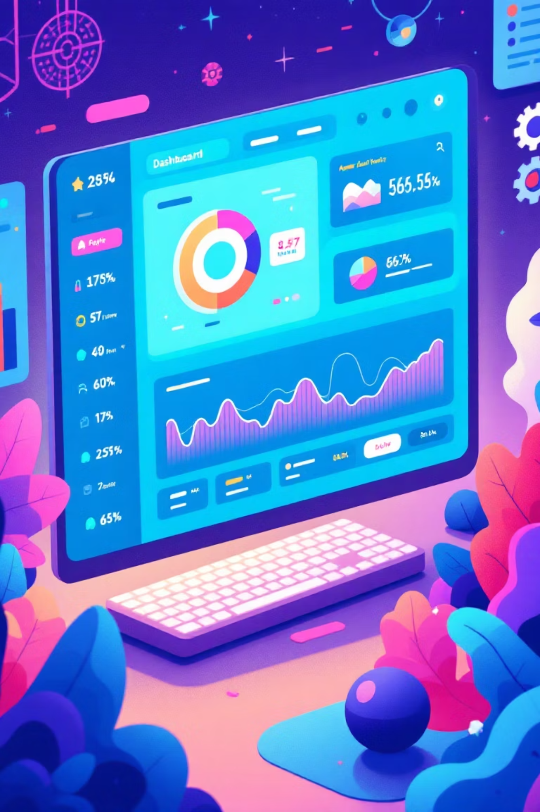
Engineering Predictable Revenue
Elevate your go-to-market strategy with expert automation and engineering solutions. We empower B2B SaaS companies to achieve predictable revenue growth by building robust technical infrastructure.
Our services span from optimizing outbound prospecting to **streamlining content creation**, ensuring every facet of your GTM operations is engineered for maximum efficiency.
Ready to drive predictable growth? Connect with us to unlock your full market potential.

Slide 2
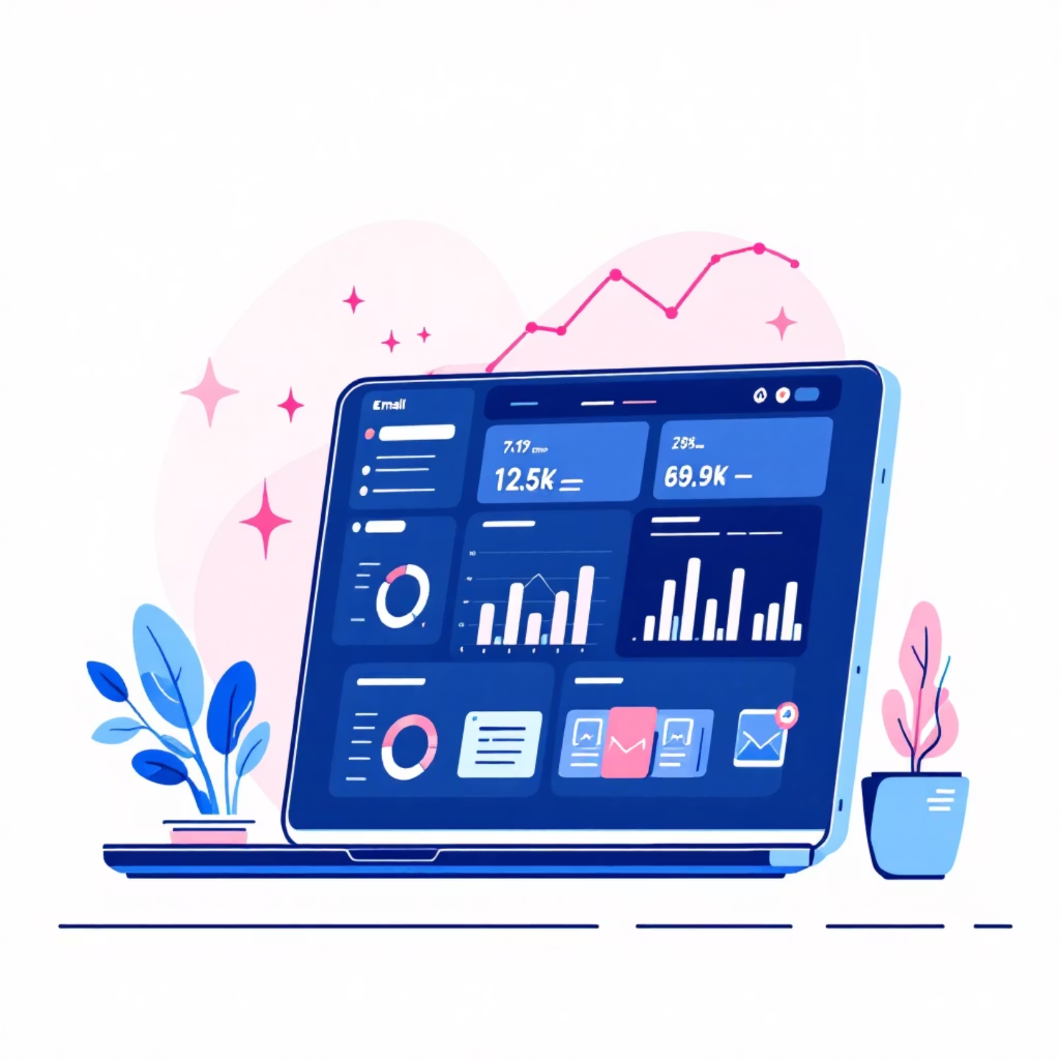
Precision Outbound Automation: Drive Predictable Revenue
Hyper-Personalized Engagement at Scale
Implement sophisticated outbound automation designed to maximize your reach and impact. We configure processes that deliver personalized emails directly to contacts within your CRM.
Each message is meticulously crafted based on:
Prospect Data: Deep insights inform every communication.
Company Research: Tailored content that resonates.
Behavioral Triggers: Timely engagement for maximum effect.
Our system dynamically updates your CRM with essential metrics:
Activity & Response Rates: Understand interaction patterns.
Engagement Data: Gain real-time insights into prospect behavior and campaign performance, empowering your sales team with actionable intelligence.

Slide 3
Mastering Inbound Leads
01
02
03
Effortless Lead Capture
Precision Lead Routing
Dynamic Nurturing & Follow-up
Automatically capture and enrich inbound leads. Gather comprehensive company and contact information. This ensures leads are **fully prepared for sales before initial contact.**
Route qualified leads to the optimal sales representatives. **Ensure perfect alignment by territory, deal size, and industry vertical.** Leverage custom SQL scoring criteria for maximum efficiency.
Deploy personalized, automated message sequences that **nurture leads effectively through your sales funnel.** Strategically maintain critical human touchpoints for higher conversion rates.
This sophisticated system ensures **no lead ever falls through the cracks**, empowering your sales team with the essential context needed for **high-impact conversations from day one.****Elevate your sales pipeline today.**

Slide 4

Maximize Multi-Channel Content Impact
LinkedIn Engagement
Strategic Social Posts
Thought Leadership Blogs
Craft **personalized, high-impact LinkedIn messages** (up to 2,700 characters) that resonate with your ICP. Drive meaningful conversations and accelerate pipeline generation.
Deliver **engaging, optimized social media content** (e.g., 170-character X.com posts). Amplify brand awareness and foster interaction within your target market.
Generate **SEO-optimized, thought-leading blog posts** (approx. 1,200 words). Establish market authority and consistently drive qualified inbound traffic.
Our advanced content engine **transforms your raw data into compelling, multi-channel narratives**. Each piece is meticulously customized to your brand's voice and Ideal Customer Profile, ensuring maximum relevance and impact. **Elevate your outreach. Drive engagement. Scale your impact.**

Slide 5

Accelerated Team Enablement
Scalable Onboarding Solutions
We develop comprehensive enablement videos, meticulously designed to accelerate new team member proficiency in deploying and managing your automation systems. Our materials cover essential setup procedures, industry best practices, and efficient troubleshooting techniques.
Significantly reduce onboarding time for rapid productivity.
Ensure consistent system implementation across your entire organization.
Minimize redundant training efforts as your team scales and evolves.
These evergreen resources empower your team with immediate access to critical knowledge, fostering self-sufficiency and driving operational excellence.
Ready to elevate your team's performance? Discover our tailored enablement strategies.

Slide 6

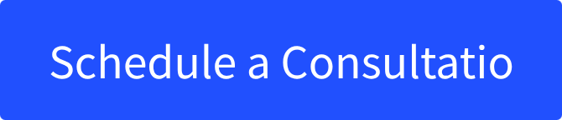
Custom AI Assistants: Powering Business Efficiency
Automation Assistant
Email Generator
SEO Content Writer
Streamline workflow setup and optimization. Deploy new automations faster and more efficiently, minimizing manual effort.
Generate personalized email sequences aligned with your brand voice. Optimize prospect engagement and achieve campaign objectives.
Produce search-optimized content that drives organic traffic. Maintain your brand's unique voice and key messaging consistently.
Each assistant is meticulously trained on your specific brand voice, proprietary company data, and industry expertise. This ensures consistent, high-quality output that sounds authentically like your team, driving impactful results.

Slide 7


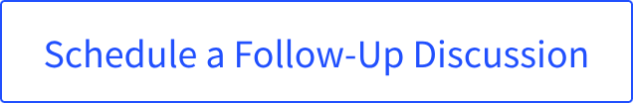
Unlocking Predictable Revenue for [CUSTOMER COMPANY NAME]
GTM Engineering Services presents a strategic proposal to revolutionize [CUSTOMER COMPANY NAME]'s go-to-market strategy through engineering-driven automation. Our bespoke solutions are precisely designed to address [SPECIFIC CHALLENGE] within the [CUSTOMER INDUSTRY] market, ensuring consistent, scalable growth and a clear path to predictable revenue.Our ultimate goal: to empower your team to achieve [DESIRED OUTCOME].
Our Strategic Approach & Implementation Timeline
01
1. Discovery & Strategy Alignment
We begin with a comprehensive analysis of [CUSTOMER COMPANY NAME]'s current GTM processes to identify key automation opportunities. This phase includes collaborative workshops to define specific goals and tailor a strategic roadmap.
Deliverable: Detailed Automation Strategy & Roadmap
Timeline: [X] weeks (e.g., 2 weeks)
02
2. Custom Solution Design & Development
Based on the approved strategy, our expert engineers will design and develop bespoke automation solutions, ensuring seamless integration with your existing tech stack (e.g., CRM, marketing automation platforms).
Deliverable: Bespoke Automation Platform/Tools
Timeline: [Y] weeks (e.g., 6-8 weeks)
03
3. Implementation & Team Enablement
We deploy the custom solutions, guaranteeing proper functionality and robust data flow. Comprehensive training is provided to your team to maximize adoption, efficiency, and long-term success.
Deliverable: Fully Operational Automation System, Team Training
Timeline: [Z] weeks (e.g., 2-3 weeks)
04
4. Optimization & Ongoing Partnership
Post-implementation, we monitor performance, gather crucial feedback, and provide continuous optimization and support to ensure sustained growth and agile adaptation to evolving market needs.
Deliverable: Performance Reports, Ongoing Support & Iteration
Timeline: Ongoing (e.g., Quarterly Reviews)
We are confident this partnership will unlock significant efficiencies and accelerated revenue growth for [CUSTOMER COMPANY NAME]. For complete details on pricing and terms, please review the full proposal document.

